Slide 2
The CounterpointeSRE / Hannon Armstrong Partnership
The real estate acumen and financial strength to get the job done
CounterpointeSRE has been financing C-PACE assessments since its inception in 2014.
Hannon Armstrong (NYSE: HASI), a Public REIT in the sustainable infrastructure markets for over 25 years, has approximately $5 billion of managed assets as of 6/30/2018 with nearly $2.5 billion on balance sheet.
In the last year, Hannon Armstrong has closed transactions valued at more than $1.2 billion.
Expert commercial property knowledge and resources to finance sustainable energy efficiency and resiliency upgrades for the commercial real estate industry- regardless of the project’s complexity

Slide 3
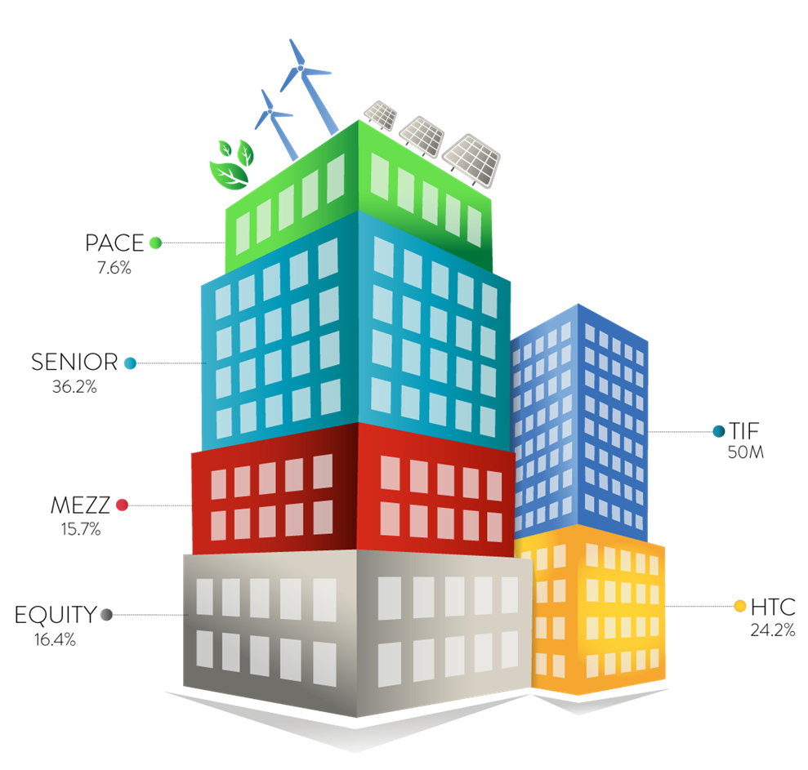
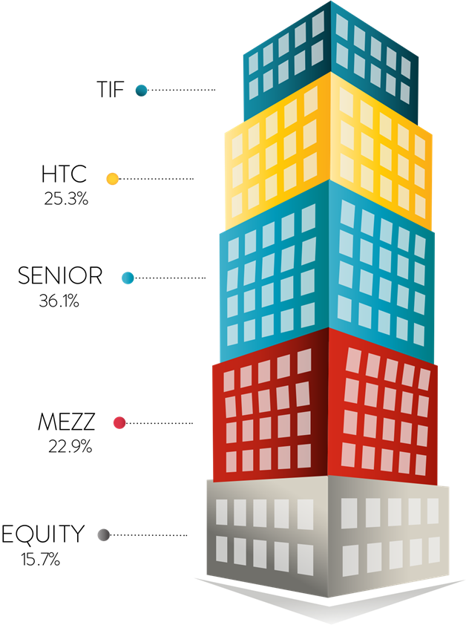
C-PACE is Ideal for Complex Capital Stacks

Slide 4
HYATT CENTRIC: C-PACE Financing as a Cost Effective Substitute to Equity
The Challenge:
Without a cost effective way to supplement equity, the proposed rehab and rebuild of a new upscale Hyatt Centric hotel in Sacramento, CA was at risk. Market conditions caused higher material costs to the project, increasing the equity requirement. The capital stack included a first mortgage construction loan, preferred equity, a subordinate city economic development loan and equity.
The Solution:
C-PACE financing was used as an alternative to raising $5.5 million of equity and an additional $5 million of higher cost floating rate debt in the capital stack.
The Result:
The property owner is saving an estimated $1.5 million of interest carry during the development and stabilization period of the project. The C-PACE is also reducing the amount of equity needed for the project, allowing the property owner to achieve its return hurdles without giving up an ownership stake in the property. It also removes both interest rate risk and term risk from the most critical stage of the redevelopment of the asset.
$10,466,025 25yr FIXED RATE C-PACE FINANCING
$1,551,065 INTEREST SAVINGS OVER 3 YEARS
$1,020,187 ENERGY SAVINGS
1,037 LIVES SAVED

